Slide 1
MFB Information Session
ARCHITECTURE.BUSINESS.DENTAL.ENVIRONMENT.LAW.MEDICAL.MICROFINANCE.PUBLIC HEALTH.WATER
www.globalbrigades.org

Slide 2
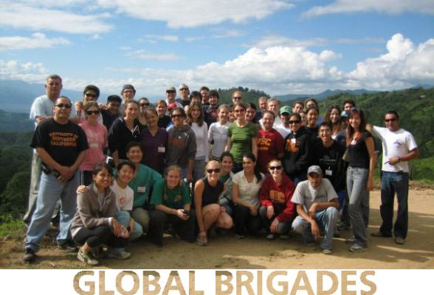
Global Brigades, Inc. Copyright 2009
Brigades Def’n. A group of passionate volunteers who move toward positive social change.
Global Brigades is the world’s largest student-led global health and sustainable development organization. As a secular, international nonprofit organization, we mobilize student volunteers and professionals to empower communities in developing countries with programs that improve quality of life while respecting local culture and improving the environment.
Between 2008 and 2009, more than 4,000 volunteers from 80 GB university chapters in the U.S., Canada, and U.K. traveled to provide health and economic development solutions to more than 50,000 beneficiaries through our teams in Panama and Honduras.
ABOUT.LOCATION.VIDEO.BRIGADES.FOLLOW-UP.SCHEDULE.LODGING.PROGRAM FEE.JOIN

Slide 3
Global Brigades, Inc. Copyright 2009
ABOUT.LOCATION.VIDEO.BRIGADES.FOLLOW-UP.SCHEDULE.LODGING.PROGRAM FEE.JOIN
Notes:
Medical Brigades provides relief.
Water and Public Health Brigades begin preventative work and infrastructure development.
Microfinance Brigades fills in the final gaps

Slide 4
Global Brigades, Inc. Copyright 2009
MICROFINANCE BRIGADES
Provides the educational, financial, and organizational resources needed to empower community leaders to continue, expand upon, and maintain well into the future the development projects put in place by other Global Brigades programs.
ABOUT.LOCATION.VIDEO.BRIGADES.FOLLOW-UP.SCHEDULE.LODGING.PROGRAM FEE.JOIN

Slide 5
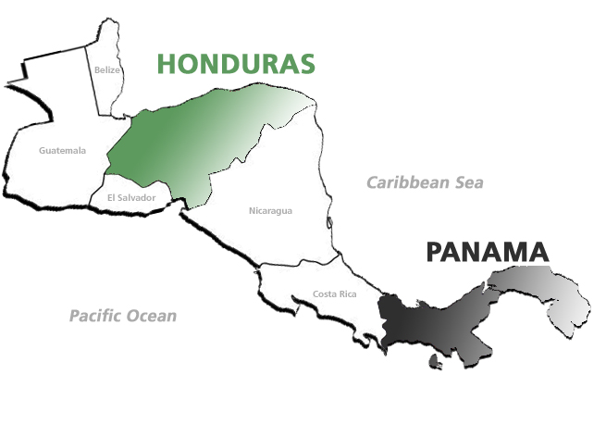
Global Brigades, Inc. Copyright 2009
Typical family income is less than
$2 per day
Average level of education is
approximately 5th grade
Limited to no access to microfinance
Areas of high biodiversity at risk
of environmental degradation
ABOUT.LOCATION.VIDEO.BRIGADES.FOLLOW-UP.SCHEDULE.LODGING.PROGRAM FEE.JOIN
Notes:
Business Brigades are available in Panama and Microfinance Brigades are available in Honduras. These statistics provide an overview of one of our average community partners.
DID YOU KNOW?
Panama has the 4th highest wealth disparity in all of Latin America and 1st highest in all of Central America
For 2007, 56.8% of the unemployed Hondurans have done up to elementary school. The relationship between education-income per capita in a household is $53 for someone who has had elementary school education, while if the head of the family has received a superior education the income can be up to $391.
As of 2003, 49% of all Panamanians and 57% of all poor in Panama are citizens less than 20 years old increasing a dire need for more youth opportunity

Slide 6
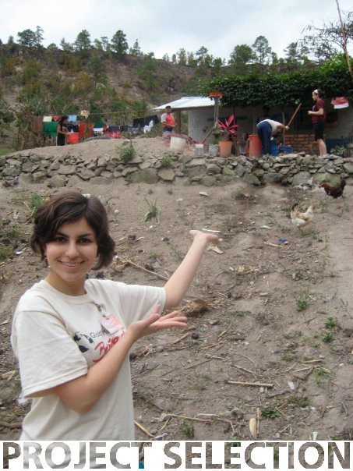
Global Brigades, Inc. Copyright 2009
MFB has targeted community members in two specific communities: Francisco Morazán and El Paraiso. Both are remote communities in mountainous regions characterized by their vulnerability to drought and dependency on subsistence farming.
ABOUT.LOCATION.VIDEO.BRIGADES.FOLLOW-UP.SCHEDULE.LODGING.PROGRAM FEE.JOIN

Slide 7
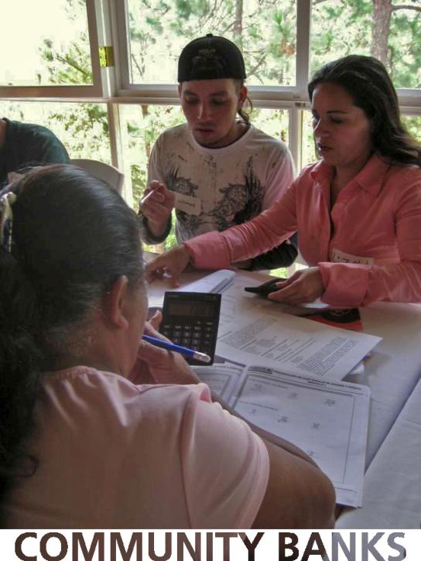
Global Brigades, Inc. Copyright 2009
Global Brigades, Inc. Copyright 2009
Step 1: Solidify community microfinance “caja rural” co-op banks
Formal and intensive MF administrative training
3 days offsite/module
1 module/month x 4 months
Bi-monthly technical follow-up assistance
Caja Rural exchanges
ABOUT.LOCATION.VIDEO.BRIGADES.FOLLOW-UP.SCHEDULE.LODGING.PROGRAM FEE.JOIN
Notes:
Volunteers can participate in Microfinance Brigades beginning March 2010. Contact Merrilee Chapin at merrilee@globalbrigades.org for brigade details.

Slide 8
Global Brigades, Inc. Copyright 2009
Global Brigades, Inc. Copyright 2009
Step 2: Custom Capitalization Projects
Pajarillos
Installation of irrigation line to community (with GWB)
Caja Rural managed Plantain training farm
GB Operational loan and bi-monthly visits from EDA Agricultural Engineer
Joyas del Carballo
Public Health Construction Projects (with GPHB)
Trained by PH team and funded with beneficiary collaborations, PH surplus, and other activities to continue, expand, and maintain PH projects
ABOUT.LOCATION.VIDEO.BRIGADES.FOLLOW-UP.SCHEDULE.LODGING.PROGRAM FEE.JOIN
Notes:
Volunteers can participate in Microfinance Brigades beginning March 2010. Contact Merrilee Chapin at merrilee@globalbrigades.org for brigade details.

Slide 9
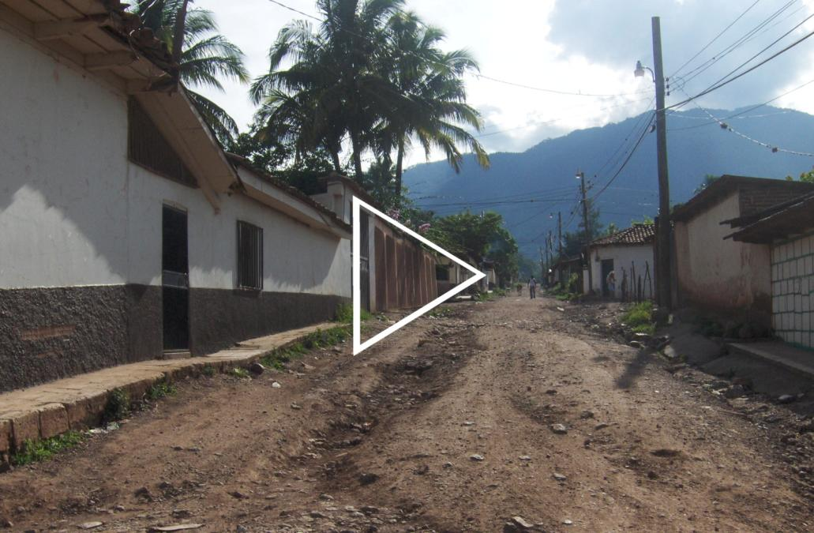
Global Brigades, Inc. Copyright 2009
ABOUT.LOCATION.VIDEO.BRIGADES.FOLLOW-UP.SCHEDULE.LODGING.PROGRAM FEE.JOIN
Notes:
http://www.youtube.com/watch?v=ET46mPDVGIQ

Slide 10
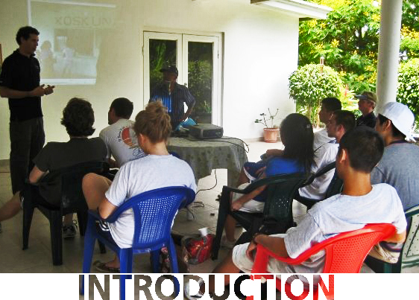
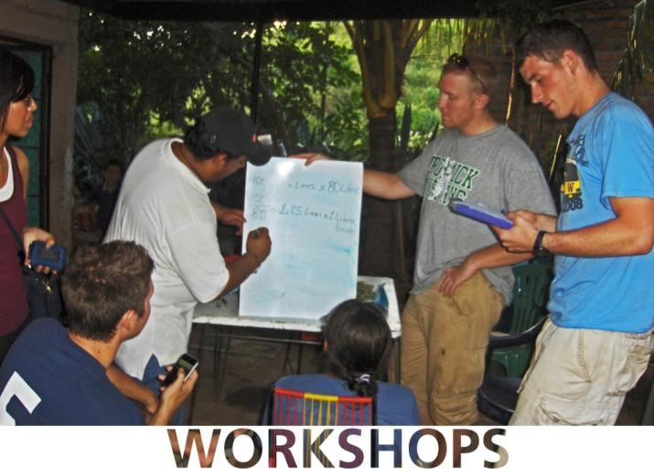
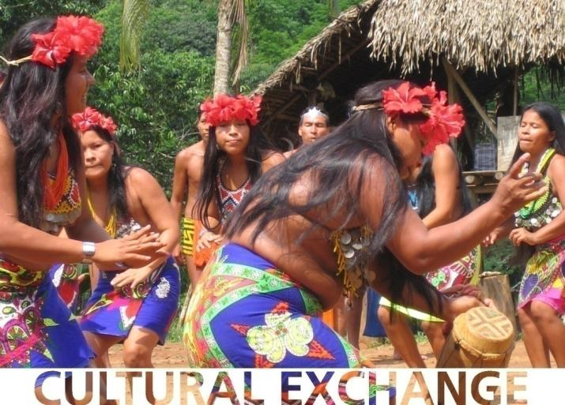
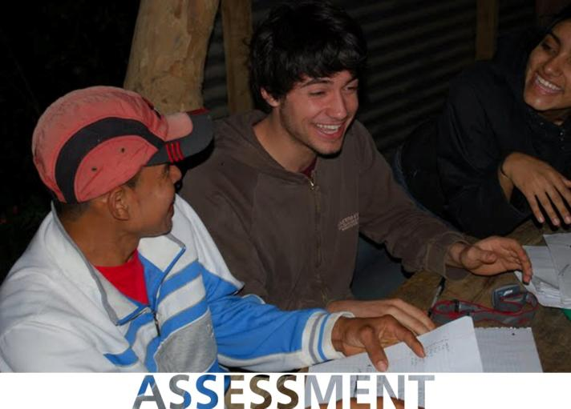
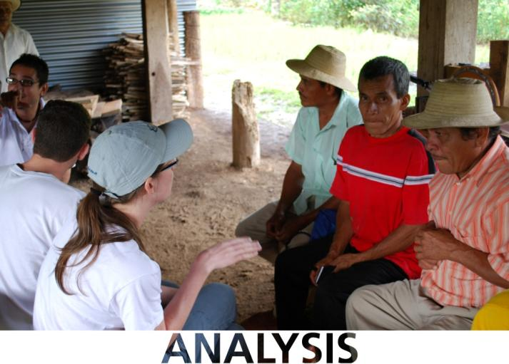
Global Brigades, Inc. Copyright 2009
Global Brigades, Inc. Copyright 2009
Although specific projects vary for each club, a brigade incorporates the following phases: introduction, assessment, analysis, workshops, capital investment, tangible solutions, and cultural exchange.
After getting to know the borrowers financial needs and opportunities, as well as learning about other GB community development projects, each brigader personally identifies how to spend their “capital investment” donation to improve fiscal sustainability.
The first two days are spent receiving an introduction to Honduras’ political, economic and cultural context, MFB’s role in sustainable development, and trainings from Microfinance organizations about different local and international methodologies.
Once in the field, volunteers begin by breaking up into their project teams to learn as much as they can about the current operations and finances of the community MF bank from its stakeholders.
Volunteers then spend time with individual borrowers to learn about their struggles, experiences with microcredit, investment opportunities, and dreams for the future.
Brigaders will provide short workshops on personal finance and basic business practices to the borrowers to improve their loan investment opportunities and sustainability.
There is also an opportunity to get your hands dirty working a day with Water and Public Health Brigades community infrastructure projects and provide a tangible impact.
Throughout the brigade the
volunteers have the opportunity
to participate in a variety of
cultural exchange activities.
ABOUT.LOCATION.VIDEO.BRIGADES.FOLLOW-UP.SCHEDULE.LODGING.PROGRAM FEE.JOIN

Slide 11
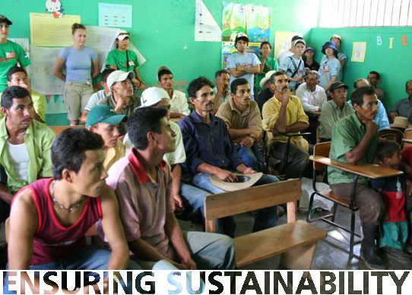
Global Brigades, Inc. Copyright 2009
Global Brigades, Inc. Copyright 2009
Between brigades our in-country team maintains relationships with partner organizations and communities to provide follow-up and measure outcomes. Partners include: Kiva, FINCA, FUNDER, FINTRAC, and local governments, among others.
ABOUT.LOCATION.VIDEO.BRIGADES.FOLLOW-UP.SCHEDULE.LODGING.PROGRAM FEE.JOIN

Slide 12
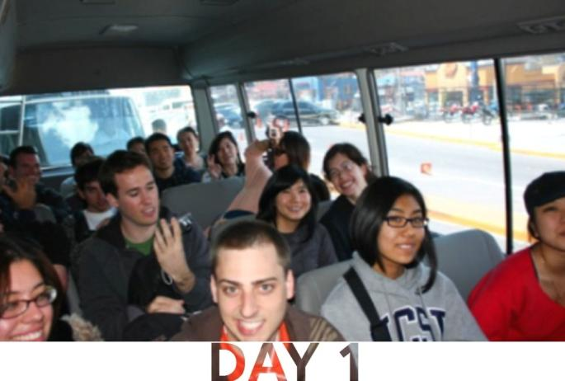
Global Brigades, Inc. Copyright 2009
12:00pm: Flight arrives in Honduras
12:30pm: Transport to FINCA training center
1:00pm: Lunch at FINCA center
2:00pm: Transport to Picacho (tourist site)
2:30pm: Picacho tour & MFB orientation
5:00pm: Transport to FINCA center
6:30pm: Dinner at FINCA center
7:30pm: Team reflection and bonding
ABOUT.LOCATION.VIDEO.BRIGADES.FOLLOW-UP.SCHEDULE.LODGING.PROGRAM FEE.JOIN

Slide 13
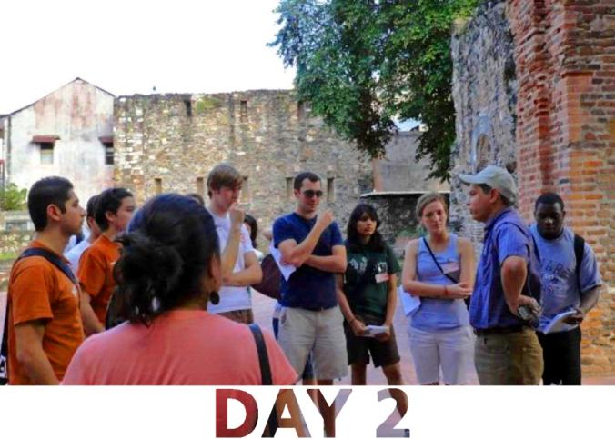
Global Brigades, Inc. Copyright 2009
7:00am: Breakfast at FINCA center
8:00am: FINCA workshop
Intro to FINCA International
Intro to Honduras MF Landscape
12:30pm: Lunch
1:30pm: FINCA workshop continued
FINCA HN Operations
Client training
4:00pm: Transport to Nuevo Paraiso
6:00pm: Dinner at Nuevo Paraiso
7:00pm: Team reflection and bonding
ABOUT.LOCATION.VIDEO.BRIGADES.FOLLOW-UP.SCHEDULE.LODGING.PROGRAM FEE.JOIN

Slide 14
Global Brigades, Inc. Copyright 2009
7:00am: Breakfast at Nuevo Paraiso
8:00am: Transport to FINCA Branch office
FINCA Borrow visits with loan officers
12:30pm: Lunch
1:30pm: FUNDER workshop
“Caja Rural” community co-op bank model as mechanisms for self-reliant development
4:00pm: Visit SAN Orphanage
6:00pm: Dinner at Nuevo Paraiso
7:00pm: Team reflection and bonding
ABOUT.LOCATION.VIDEO.BRIGADES.FOLLOW-UP.SCHEDULE.LODGING.PROGRAM FEE.JOIN

Slide 15
Global Brigades, Inc. Copyright 2009
7:00am: Breakfast at Nuevo Paraiso
8:00am: Transport to communities
9:30am: Cultural Exchange Activity
12:30pm: Sandwich Lunch
1:30pm: Meeting with the community bank
SWOT Analysis and defining goals
3:30pm: Transport to Nuevo Paraiso
6:00pm: Dinner at Nuevo Paraiso
7:00pm: Team reflection and prep for community training
ABOUT.LOCATION.VIDEO.BRIGADES.FOLLOW-UP.SCHEDULE.LODGING.PROGRAM FEE.JOIN

Slide 16
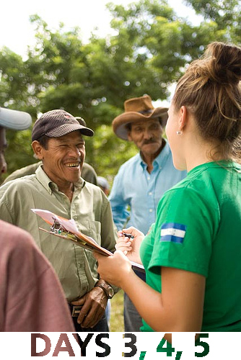
Global Brigades, Inc. Copyright 2009
7:00am: Breakfast
8:00am: Transport to communities
9:30am: Individual Borrower visits/interviews
12:00pm: Sandwich Lunch
1:00pm: Community Action
Personal Finance Workshop
3:30pm: Transport to Nuevo Paraiso
6:00pm: Dinner
7:00pm: Team Reflection
ABOUT.LOCATION.VIDEO.BRIGADES.FOLLOW-UP.SCHEDULE.LODGING.PROGRAM FEE.JOIN
Notes:
Cultural activity: Learning from the communities traditions (i.e. handcrafts making, harvesting coffee, planting yucca, indigenous dances, body paint, etc. )

Slide 17
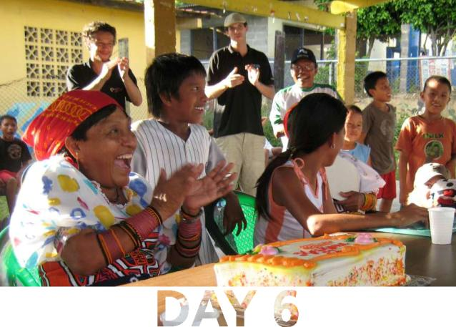
Global Brigades, Inc. Copyright 2009
7:00am: Breakfast
8:00am: Transport to communities
9:30am: Individual Borrower visits/consulting
1:30pm: Transport to Valle de Angeles
Lunch, shopping, free-time
5:00pm: Transport to Nuevo Paraiso
6:00pm: Dinner
7:00pm: Community Investment Fund allocations
8:00pm: Feedback Surveys
9:00pm: Fiesta!
ABOUT.LOCATION.VIDEO.BRIGADES.FOLLOW-UP.SCHEDULE.LODGING.PROGRAM FEE.JOIN
Notes:
Day 7 will be spent going to the airport, saying good-byes, and traveling back home.

Slide 18
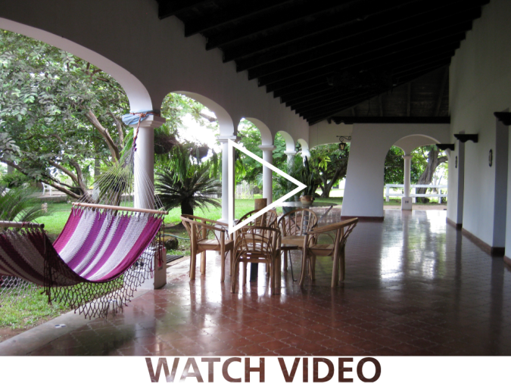
Global Brigades, Inc. Copyright 2009
Electricity, showers, and linens
Laundry and room cleaning
Private chefs prepare nutritious food
Security on duty
Internet cafe
ABOUT.LOCATION.VIDEO.BRIGADES.FOLLOW-UP.SCHEDULE.LODGING.PROGRAM FEE.JOIN
Notes:
http://www.youtube.com/watch?v=IpUE_EOhgXI

Slide 19
Global Brigades, Inc. Copyright 2009
$750 + Airfare
Included in program fee:
7 days and 6 nights program
Accommodations and meals
In-country transportation
Spanish translators and coordinators
Program sustainability
Capital Investment Fund ($100)
ABOUT.LOCATION.VIDEO.BRIGADES.FOLLOW-UP.SCHEDULE.LODGING.PROGRAM FEE.JOIN
Notes:
*Global Brigades is 100% student funded and led. We are not reliant on any outside donations or grants to perpetuate our programming. As such, we focus on empowering students with the tools and resources to solicit support for their individual brigades. The "sustainability expense" enables us to maintain offices in Honduras and Panama, hire full-time local directors, provide housing for our long-term volunteers and manage the relationships and health trends in the communities we serve year-round.

Slide 20
Global Brigades, Inc. Copyright 2009
Join the next Microfinance Brigade!
Global Microfinance Brigades at Indiana University Executive Team:
NAME
President
Email:
Phone Number:
Photo
Here
NAME
President
Email:
Phone Number:
Photo
Here
ABOUT.LOCATION.VIDEO.BRIGADES.FOLLOW-UP.SCHEDULE.LODGING.PROGRAM FEE.JOIN

Slide 21
Questions?
ARCHITECTURE.BUSINESS.DENTAL.ENVIRONMENT.LAW.MEDICAL.MICROFINANCE.PUBLIC HEALTH.WATER
www.globalbrigades.org

Slide 22
INSERT TITLE
Insert additional slides for chapter updates or
pictures of your last brigade.

Slide 23
INSERT TITLE
Insert additional slides for chapter updates or
pictures of your last brigade.

